Slide 1

Zero >>> Hero
Twitter: @igorzg1987
Github: igorzg Code sapmles

Slide 2
genda
Dependency Injection
Modules
Routing
Services
Data binding
Templates
Directives
Components
Component Lifecycle
Pipes
Http Client
Forms
Testing

Slide 3
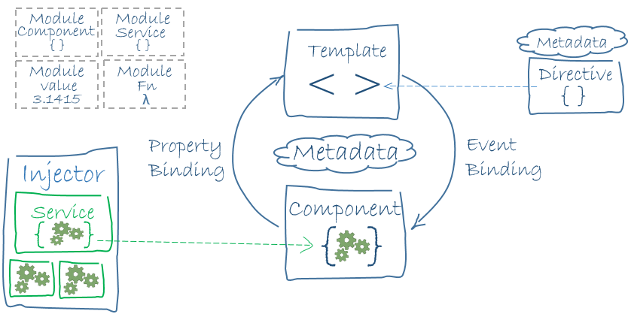
The big picture

Slide 4
Dependency Injection
Angular DI is an hierarchical injection system, which means that nested injectors can create their own service instances.
Reflect-metadata - library to get metadata definitions from a class declaration, method, accessor, property. Stage 1 proposal for javascript decorators.
Decorators - @Component, @Directive, @NgModule, @Pipe, @Input, @Output, @Self, @Inject, @SkipSelf, @Host, @Optional, @ContentChildren, @ViewChild, @HostBinding, @HostListener are used by di system in order to provide nice api.
@Injectable() - marks a class as available to an injector for instantiation, use them on services.
providers - creators of services , provide service name in providers list in order that Injector creates an new instance of that service on that object in di tree.

Slide 5
Dependency Injection
4 Ways of defining providers
providers: [
{ provide: “local”, multi: true, useValue: “hr”},
{ provide: “local”, multi: true, useValue: “de”}, UserService, { provide: UserService, useClass: UserService },
{ provide: UserService, useValue: new UserService() },
{
provide: UserService,
useFactory: (a: ServiceA, b: ServiceB) => new UserService(a, b),
deps: [ServiceA, ServiceB]
} ]

Slide 6
Dependency Injection
@Component({ providers: [ { provide: “value”, useValue: “Igor” } ] }) class MyService { // This does not work :( @Inject(ServiceA) serviceA: ServiceA; constructor(private logger: Logger, @Optional() userService: UserService, @Inject(“value”) myname: string) { this.logger.log(myname); } ngOnInit() { this.logger.log(“log me”); } }
Notes:
serviceA is not available during object initialization time!

Slide 7
@NgModule
NgModule is a decorator function that takes a single metadata object whose properties describe the module. The most important properties are:
declarations - the view classes that belong to this module: components, directives, and pipes.
exports - the subset of declarations that should be visible and usable in the component templates of other modules.
imports - other modules whose exported classes are needed by component templates declared in this module.
providers - creators of services that this module contributes to the global collection of services; they become accessible in all parts of the app.
eg. FormsModule, HttpModule, RouterModule
bootstrap - the main application view, called the root component, that hosts all other app views.

Slide 8
@NgModule
Every angular application requires at least one module root module.
@NgModule({ imports: [ BrowserModule ], declarations: [ AppComponent ], bootstrap: [ AppComponent ] }) export class AppModule { }
Never re-declare classes that belong to another module.

Slide 9
@NgModule
Static Bootstraping with AOT (Ahead of Time) compiler In the static option, the Angular compiler runs ahead-of-time as part of the build process, producing a collection of class factories in their own files.
// The browser platform without a compiler import { platformBrowser } from '@angular/platform-browser'; // The app module factory produced by the static offline compiler import { AppModuleNgFactory } from './app.module.ngfactory'; // Launch with the app module factory. platformBrowser().bootstrapModuleFactory(AppModuleNgFactory);
Because the entire application was pre-compiled, Angular Compiler is not shipped to the browser and angular is not compiling in the browser.
Notes:
Consider the static alternative which can produce a much smaller application that launches faster, especially on mobile devices and high latency networks.

Slide 10
@NgModule
Dynamic Bootstraping with JIT compiler
// The browser platform with a compiler import { platformBrowserDynamic } from '@angular/platform-browser-dynamic'; // The app module import { AppModule } from './app.module'; // Compile and launch the module platformBrowserDynamic().bootstrapModule(AppModule);
Notes:
On large applications consider this option because we don’t want to download all files on application load. Other option is for example installing widgets on the fly or 3 party api limitations is perfect case.

Slide 11
Router
The Angular Router enables navigation from one view to the next as users perform application tasks.
All routes are defined on @NgModule:
forRoot creates a module that contains all the directives, the given routes, and the router provider itself we use this only once on Root Module.
forChild creates a module that contains all the directives and the given routes, but does not include the router provider we define it multiple times on lazy/eager loaded child modules.
@NgModule({ imports: [RouterModule.forRoot(Routes)] }) class MyNgModule {}

Slide 12
Routing
`Routes` is an array of route configurations. Each one has the following properties:
`path` is a string that uses the route matcher DSL.
`pathMatch` is a string that specifies the matching strategy.
`component` is a component type.
`redirectTo` is the url fragment which will replace the current matched segment.
`outlet` is the name of the outlet the component should be placed into.
`canActivate` array of tokens used to look up CanActivate handlers ( checking route access ).
`canActivateChild` array of tokens used to look up CanActivateChild handlers ( checking child route access ).
`canDeactivate` array of tokens used to look up CanDeactivate handlers ( ask permission to discard unsaved changes ).
`canLoad` is an array of tokens used to look up CanLoad handlers ( check before loading feature module assets ).
`data` is additional data provided to the component via `ActivatedRoute`.
`resolve` is a map of DI tokens used to look up data resolvers (pre-fetching route data)
`children` is an array of child route definitions.

Slide 13
Routing
@NgModule({ imports: [ BrowserModule, RouterModule.forRoot([ { path: 'hero/:id', component: HeroComponent }, { path: 'contact', component: ContactHeroComponent}, { path: '', component: HomeComponent }, { path: '**', component: PageNotFoundComponent } ]) ],
…. bootstrap: [ AppComponent ] }) export class AppModule {}
Notes:
The order of the routes in the configuration matters and this is by design. The router uses a first-match wins strategy when matching routes, so more specific routes should be placed above less specific routes.

Slide 14
Routing
Router Outlet and Router Link
template: ` <h1>Angular Router</h1> <nav> <a routerLink="/users" routerLinkActive="active">Users</a> <a routerLink="/contacts" routerLinkActive="active">Contacts</a> </nav> <router-outlet></router-outlet> `
Notes:
After the end of each successful navigation lifecycle, the router builds a tree of ActivatedRoute objects that make up the current state of the router. We can access the current RouterState from anywhere in our application using the Router service and the routerState property

Slide 15
Routing
Router - Displays the application component for the active URL. Manages navigation from one component to the next. RouterModule - A separate Angular module that provides the necessary service providers and directives for navigating through application views. Routes - Defines an array of Routes, each mapping a URL path to a component. Route - Defines how the router should navigate to a component based on a URL pattern. Most routes consist of a path and a component type. RouterOutlet - The directive (<router-outlet>) that marks where the router should display a view. RouterLink - The directive for binding a clickable HTML element to a route. Clicking an anchor tag with a routerLink directive that is bound to a string or a Link Parameters Array triggers a navigation. RouterLinkActive - The directive for adding/removing classes from an HTML element when an associated routerLink contained on or inside the element becomes active/inactive. ActivatedRoute - A service that is provided to each route component that contains route specific information such as route parameters, static data, resolve data, global query params and the global fragment. RouterState - The current state of the router including a tree of the currently activated routes in our application along convenience methods for traversing the route tree.

Slide 16
Services
Are reusable objects which share data between components. Multiple components will need access to service data and we don't want to copy and paste the same code over and over. Instead, we'll create a single reusable data service and learn to inject it in the components that need it.
import { Injectable } from '@angular/core'; @Injectable() export class HeroService {
}
Refactoring data access to a separate service keeps the component lean and focused on supporting the view. It also makes it easier to unit test the component with a mock service.

Slide 17
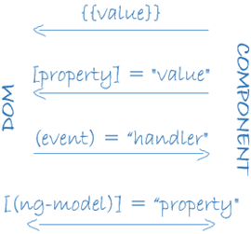
Data binding
Angular supports data binding, a mechanism for coordinating parts of a template with parts of a component. Add binding markup to the template HTML to tell Angular how to connect both sides.
As the diagram shows, there are four forms of data binding syntax. Each form has a direction — to the DOM, from the DOM, or in both directions.
Notes:
Without a framework, you would be responsible for pushing data values into the HTML controls and turning user responses into actions and value updates. Writing such push/pull logic by hand is tedious, error-prone, and a nightmare to read as any experienced jQuery programmer can attest.

Slide 18
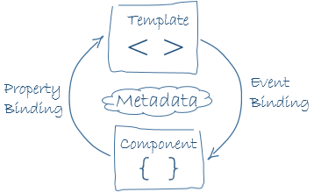
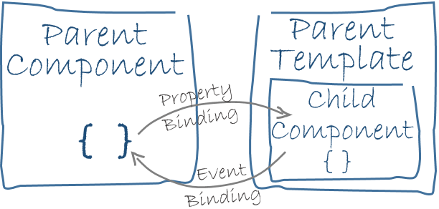
Data binding
In two-way binding, a data property value flows to the input box from the component as with property binding.
The user's changes also flow back to the component, resetting the property to the latest value, as with event binding.
Angular processes all data bindings once per JavaScript event cycle, from the root of the application component tree through all child components.
Data binding plays an important role in communication between a template and its component. Data binding is also important for communication between parent and child components.

Slide 19
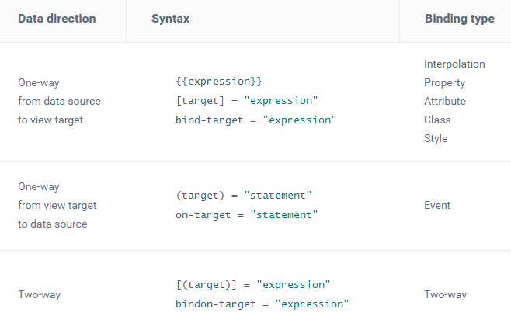
Templates
You define a component's view with its template syntax.
A template is a form of HTML that tells Angular how to render the component.
A template looks like regular HTML, except for a few differences.

Slide 20
Directives
There are three kinds of Angular directives:
Component - directive with an template extended
Attribute directive - changes the appearance or behavior of an element
Structural directive - changes the DOM layout by adding and removing DOM elements ngIf, ngSwitch and ngFor.
<div *ngIf="hero">{{hero}}</div> <div *ngFor="let hero of heroes">{{hero}}</div> <div [ngSwitch]="status"> <template [ngSwitchCase]="'in-mission'">In Mission</template> <template [ngSwitchCase]="'ready'">Ready</template> <template ngSwitchDefault>Unknown</template> </div>

Slide 21
Directives
The asterisk is "syntactic sugar"
<!-- (A) *ngIf paragraph -->
<p *ngIf="condition"> Our heroes are true! </p> <!-- (B) [ngIf] with template --> <template [ngIf]="condition"> <p> Our heroes are true! </p> </template>
<!-- (A) *ngFor div --> <div *ngFor="let hero of heroes">{{ hero }}</div> <!-- (B) ngFor with template --> <template ngFor let-hero [ngForOf]="heroes"> <div>{{ hero }}</div> </template>

Slide 22
@Directive
@Directive({ selector: '[myHighlight]' })
export class HighlightDirective {
constructor(private el: ElementRef, private renderer: Renderer) { }
@HostListener('mouseenter') onMouseEnter() {
this.renderer.setElementStyle(this.el.nativeElement, 'backgroundColor', 'yellow');
}
@HostListener('mouseleave') onMouseLeave() {
this.renderer.setElementStyle(this.el.nativeElement, 'backgroundColor', null);
}
}
exportAs - name under which the component instance is exported in a template
host - map of class property to host element bindings for events, properties and attributes
inputs - list of class property names to data-bind as component inputs
outputs - list of class property names that expose output events that others can subscribe to
providers - list of providers available to this component and its children
queries - configure queries that can be injected into the component
selector - css selector that identifies this component in a template

Slide 23
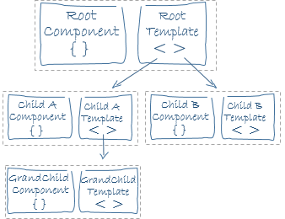
@Component
A component controls a patch of screen called a view.
import { Component, Input } from '@angular/core';
import { Hero } from './hero';
@Component({
selector: 'hero-child',
template: ` <h3>{{hero.name}} says:</h3>
<p>I, {{hero.name}}, am at your service, {{masterName}}.</p>`
})
export class HeroChildComponent {
@Input() hero: Hero;
@Input('master') masterName: string;
}
Notes:
Component decorator allows you to mark a class as an Angular component and provide additional metadata that determines how the component should be processed, instantiated and used at runtime.

Slide 24
@Component
@Component extends @Directive Metadata Properties:
animations - list of animations of this component
changeDetection - change detection strategy used by this component
encapsulation - style encapsulation strategy used by this component
entryComponents - list of components that are dynamically inserted into the view of this component
interpolation - custom interpolation markers used in this component's template
moduleId - ES/CommonJS module id of the file in which this component is defined
styleUrls - list of urls to stylesheets to be applied to this component's view
styles - inline-defined styles to be applied to this component's view
template - inline-defined template for the view
templateUrl - url to an external file containing a template for the view
viewProviders - list of providers available to this component and its view children
A component must belong to an NgModule in order for it to be usable by another component or application.
To specify that a component is a member of an NgModule, you should list it in the declarations field of that NgModule.
In addition to the metadata configuration specified via the Component decorator, components can control their runtime behavior by implementing various Life-Cycle hooks.
Notes:
Components are the most basic building block of an UI in an Angular application. An Angular application is a tree of Angular components. Angular components are a subset of directives. Unlike directives, components always have a template and only one component can be instantiated per an element in a template.

Slide 25
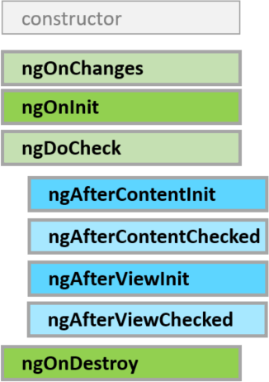
Component Lifecycle
A component has a lifecycle managed by Angular itself.
Angular creates it, renders it, creates and renders its children, checks it when its data-bound properties change, and destroys it before removing it from the DOM.
Angular offers lifecycle hooks that provide visibility into these key life moments and the ability to act when they occur.
A directive has the same set of lifecycle hooks, minus the hooks that are specific to component content and views.

Slide 26
Component Lifecycle
ngOnChanges - Respond when Angular (re)sets data-bound input properties. The method receives a SimpleChanges object of current and previous property values. Called before ngOnInit and whenever one or more data-bound input properties change.
ngOnInit - Initialize the directive/component after Angular first displays the data-bound properties and sets the directive / component's input properties. Called once, after the first ngOnChanges.
ngDoCheck - Detect and act upon changes that Angular can't or won't detect on its own. Called during every change detection run, immediately after ngOnChanges and ngOnInit.
ngAfterContentInit - Respond after Angular projects external content into the component's view. Called once after the first NgDoCheck. A component-only hook.
ngAfterContentChecked - Respond after Angular checks the content projected into the component. Called after the ngAfterContentInit and every subsequent NgDoCheck. A component-only hook.
ngAfterViewInit - Respond after Angular initializes the component's views and child views. Called once after the first ngAfterContentChecked. A component-only hook.
ngAfterViewChecked - Respond after Angular checks the component's views and child views. Called after the ngAfterViewInit and every subsequent ngAfterContentChecked.A component-only hook.
Notes:
ngOnDestroy - Cleanup just before Angular destroys the directive/component. Unsubscribe observables and detach event handlers to avoid memory leaks. Called just before Angular destroys the directive/component.

Slide 27
Pipes
Pipes are data transformers within a template.
The pipe class implements the PipeTransform interface's transform method that accepts an input value followed by optional parameters and returns the transformed value.
The @Pipe decorator allows us to define the pipe name that we'll use within template expressions.
It must be a valid JavaScript identifier. Our pipe's name is exponentialStrength.
@Pipe({ name: 'flyingHeroesImpure', pure: false })
import { Pipe, PipeTransform } from '@angular/core'; /* * Usage: * value | exponentialStrength:exponent * Example: * * formats to: 1024 */ @Pipe({name: 'exponentialStrength'}) export class ExponentialStrengthPipe implements PipeTransform { transform(value: number, exponent: string): number { let exp = parseFloat(exponent); return Math.pow(value, isNaN(exp) ? 1 : exp); } }
Notes:
A pure change is either a change to a primitive input value (String, Number, Boolean, Symbol) or a changed object reference (Date, Array, Function, Object).

Slide 28
Http Client
HTTP is the primary protocol for browser/server communication. Wrapper around XMLHttpRequest exported as two modules HttpModule, JsonpModule.
addHero (name: string): Promise<Hero> {
let headers = new Headers({ 'Content-Type': 'application/json' });
let options = new RequestOptions({ headers: headers });
return this.http.post(this.heroesUrl, { name }, options)
.toPromise()
.then(this.extractData)
.catch(this.handleError);
}

Slide 29
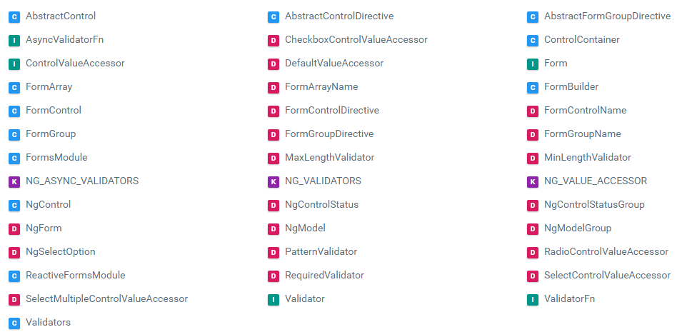
Forms - @angular/forms

